Slide 1

NeuroDOT
Tutorial:
Data Pre-processing

Slide 2
NeuroDOT Set-Up - Checklist
Before starting any tutorial, please make sure you’ve done the following
Set your path so that all required folders and subfolders are included
Folders w/subfolders to include
NeuroDOT
Any other toolbox used for whatever task
Your personal directory
Folders to include
Output directory
Set your output directory so that you can save files to the desired location
Change your current directory to your output directory
cd(outputdir)

Slide 3
NeuroDOT Set-Up – Output Directory
Once you’ve set your path, the next thing you should do is set your output directory.
The output directory must be located within your path
If it isn’t already in your path, you must add it to your path
You can set your own path to an output directory in the line shown above
An output directory specifies the location where files will be saved
MATLAB, by default, will save files to the current directory
The following line of code will change your current directory to the output directory that you just specified →
Now you can save outputs

Slide 4

Diffuse Optical Tomography
In diffuse optical tomography (DOT), arrays of optical sources and detectors are used to perform functional neuroimaging experiments on task-based or resting state modes of human brain function.
Analyses are broken into several pipelines:
B: modeling of the tissue and optical geometry
C: modeling of the light emission, diffusion, and detection through the head
D: preprocessing of the raw source-detector measurements
E: reconstruction and spectroscopy of the preprocessed data and light model into a functional neuroimaging volume
F: post-processing analysis of these results.

Slide 5

Pre-processing
This tutorial will follow the Matlab file NeuroDOT_PreProcessing_Script.m, which can be found in the Documentation/Scripts folder.
In this tutorial, you will:
Process and visualize raw source-detector measurements
Examine different ‘nearest neighbor’ measurements, with varying source-detector distance
Examine the measurement spectrum
Explore effects of filter cutoff frequencies
Examine effects of superficial signal regression
We will use data from a rotating-wedge retinotopy experiment
Start by loading this data set:
load('NeuroDOT_Data_Sample_CCW1.mat'); % data, info, flags
NeuroDOT is compatible with various raw data file formats including *.mat (shown in this tutorial), *.snirf, and *.nirs.
The PowerPoint “Tutorial_for_Loading_Raw_Data” and corresponding script “Script_for_Loading_Raw_Data” provide details on how to load raw data in these formats.

Slide 6
Pre-processing of Raw Measurements
DOT Acquisition
Log-mean
Pre-processing generally follows the pipeline on the right, as in this section of code:
lmdata = logmean(data); % Logmean Light Levels
info = FindGoodMeas(lmdata, info, 0.075); % Detect Noisy Channels
ddata = detrend_tts(lmdata); % Detrend Data
hpdata = highpass(lmdata, .02, info.system.framerate); % High Pass Filter
lp1data = lowpass(hpdata, 1, info.system.framerate); % Low Pass Filter 1
hem = gethem(lp1data, info); % Superficial Signal Regression
[SSRdata, ~] = regcorr(lp1data, info, hem);
lp2data = lowpass(SSRdata, 0.5, info.system.framerate); % Low Pass Filter 2
[rdata, info] = resample_tts(lp2data, info, 1, 1e-5); % 1 Hz Resampling
% Block Averaging
badata = BlockAverage(rdata, info.paradigm.synchpts(info.paradigm.Pulse_2), 30);
The following slides show the data at each of these stages to demonstrate the effects of pre-processing.
Previous plots of the raw signals used a log-compressed y-axis to display the wide distribution of light levels.
Subsequent plots and images show differential measurements, computed as the logarithm of the ratio of each signal and its temporal average
Detect noisy channels
Band-pass filter
Superficial signal regression
Low-pass filter
Resample
Light
Model
Reconstruction
Spectroscopy
Spatial normalization

Slide 7
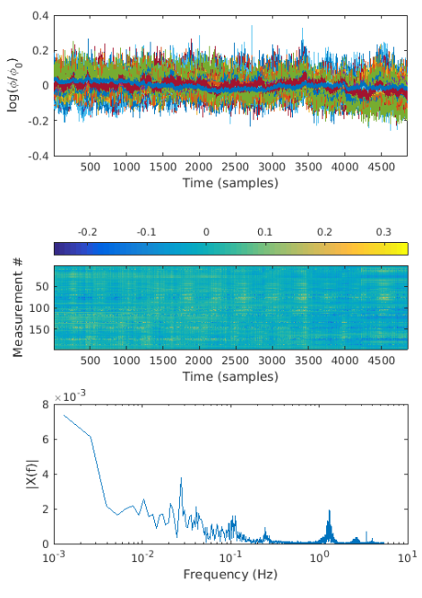
logmean data
First, take the logmean and find clean measurements (std(logmean)<0.075).
lmdata = logmean(data); % Logmean Light Levels
info = FindGoodMeas(lmdata, info, 0.075); % Detect Noisy Channels
The results can be visualized with code such as
% measurements to include
keep = info.pairs.WL==2 & info.pairs.r2d < 40 & info.MEAS.GI;
figure('Position',[300 600 550 780])
subplot(3,1,1); plot(lmdata(keep,:)')
xlabel('Time (samples)'), ylabel('log(\phi/\phi_0)')
subplot(3,1,2); imagesc(lmdata(keep,:))
colorbar, xlabel('Time (samples)'), ylabel('Measurement #')
[ftmag,ftdomain] = fft_tts(mean(lmdata(keep,:)',2)',info.system.framerate);
subplot(3,1,3); semilogx(ftdomain,ftmag)
xlabel('Frequency (Hz)'), ylabel('|X(f)|'), xlim([1e-3 10])
In a plot (top) of the clean time traces overlain on each other, any response to the stimulus is difficult to discern without additional processing.
In an image view (middle) of all measurements, a possible periodic response to the stimulus may be evident.
A plot of the average spectrum for the wavelength with stronger response (bottom) shows the pulse and stimulus frequencies as before.

Slide 8
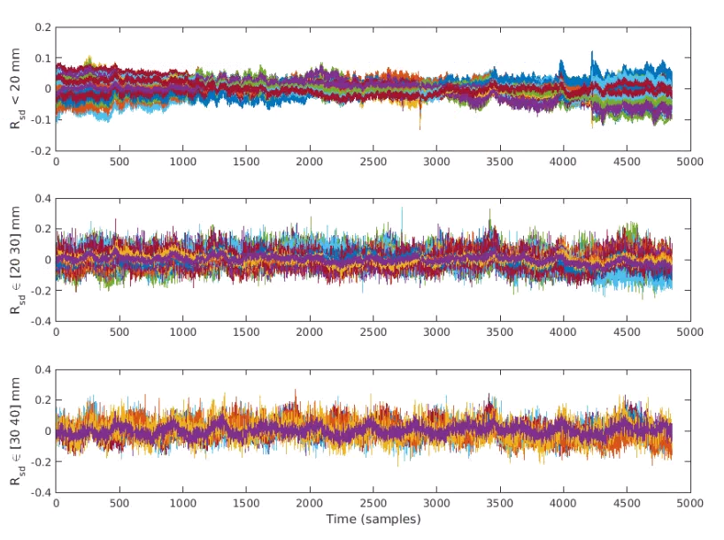
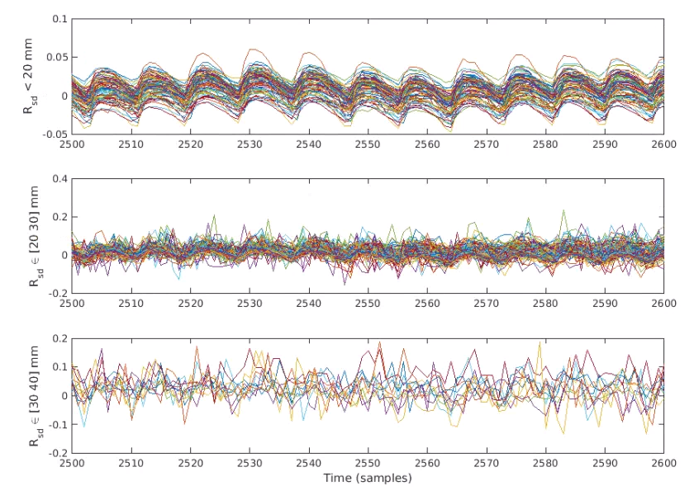
Measurements at Varying Source-detector distance
Viewing measurements from different source-detector distances can help with interpretation
Identify sets of measurements at different distances,
keepd1 = info.MEAS.GI & info.pairs.r2d<20 & info.pairs.WL==2;
keepd2 = info.MEAS.GI & info.pairs.r2d>=20 & info.pairs.r2d<30 & info.pairs.WL==2;
keepd3 = info.MEAS.GI & info.pairs.r2d>=30 & info.pairs.r2d<40 & info.pairs.WL==2;
Plot measurements at each range of distances
figure('Position',[700 300 1000 700])
subplot(3,1,1), plot(lmdata(keepd1,:)'), ylabel('R_{sd} < 20 mm')
subplot(3,1,2), plot(lmdata(keepd2,:)'), ylabel('R_{sd} \in [20 30] mm')
subplot(3,1,3), plot(lmdata(keepd3,:)'), ylabel('R_{sd} \in [30 40] mm')
xlabel('Time (samples)')
Displaying the complete time range (top figure, with short-, medium- and long-distance measurements) shows features across the full length of the recording
Reducing the displayed time range (bottom figure) zooms in on features within the data. Here the cardiac pulse (at roughly one cycle per 10 samples, or one second) is prominent
for i = 1:3, subplot(3,1,i), xlim([2500 2600]), end

Slide 9
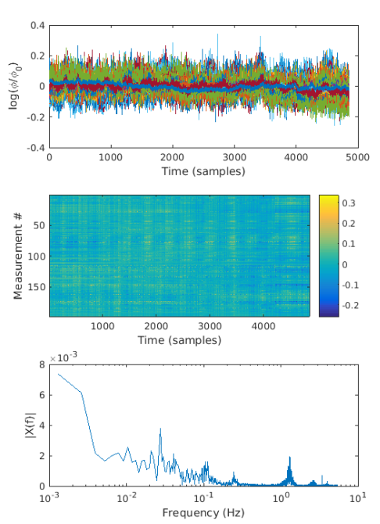

Periodic Waveforms in the Spectrum
The spectrum (bottom right and in a previous slide) is computed with a fast Fourier transform (fft) of the average of kept measurements and shows the presence of periodic, or nearly periodic waveforms in the measurements.
The cardiac pulse shown previously repeats with a period of approximately 1 second and appears as a spike at a frequency of approximately 1Hz
The stimulus in these measurements was a flashing checkerboard wedge rotating once every 36 seconds, so we expect to see it at 1/36 $≈$ 0.028 Hz
Stimulus frequency, ~0.028Hz
Cardiac pulse, ~1Hz

Slide 10
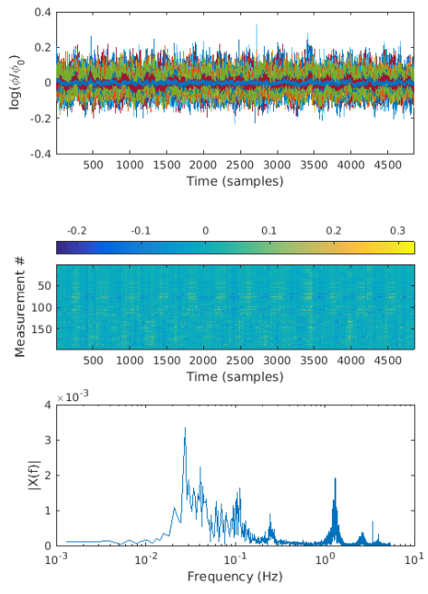
Detrend and high-pass filter the data
Detrending the data removes a linear trend or drift in each measurement
ddata = detrend_tts(lmdata); % Detrend Data
Data are high-pass filtered (cutoff frequency of 0.02 Hz here)
hpdata = highpass(ddata, .02, info.system.framerate);
The time traces plot shows subtle changes, with a slight flattening over the duration of the measurements
The spectrum (bottom) shows the effect of filtering: frequencies below the cutoff frequency are significantly attenuated (frequencies higher than the cutoff pass through the filter).
Note that the cardiac pulse and stimulus frequencies are still present in the spectrum.

Slide 11
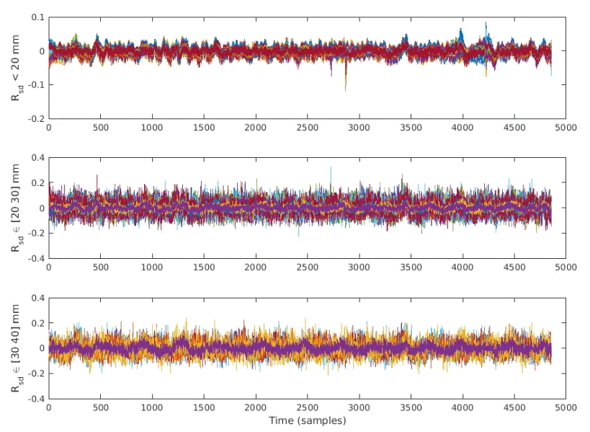
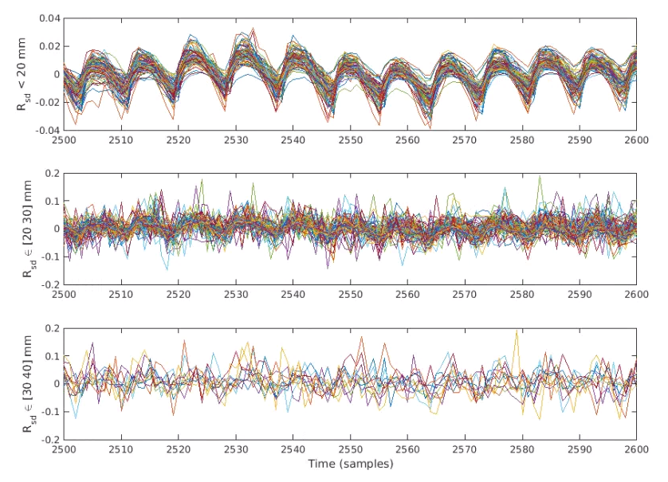
Detrend and High-Pass
Viewing the filtered measurements from different source-detector distances shows more clearly the significant reduction in low-frequency (over the course of the full measurement duration) changes, especially at the short source-detector distances
See Slide 8
The zoomed view shows closer alignment of the short source-detector distance measurements

Slide 12
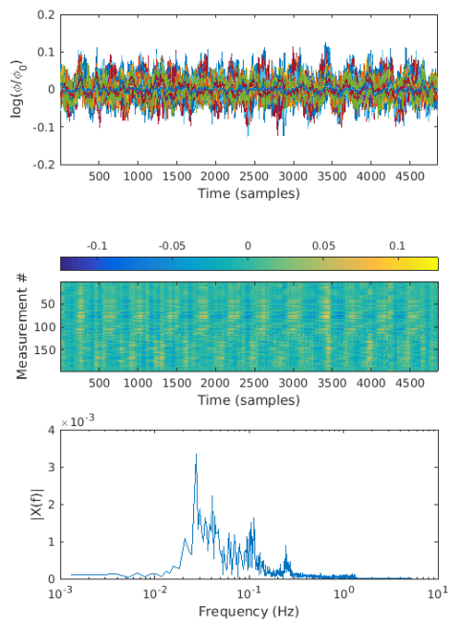
Low-pass filter the data
Data are low-pass filtered (1 Hz cutoff frequency)
lp1data = lowpass(hpdata, 1, info.system.framerate);
The time traces plot shows less high-frequency noise
The image of the measurement time traces now shows a clearer periodic response to the stimulus
The spectrum shows attenuation of frequencies above the cutoff frequency (frequencies lower than the cutoff pass through the filter)

Slide 13
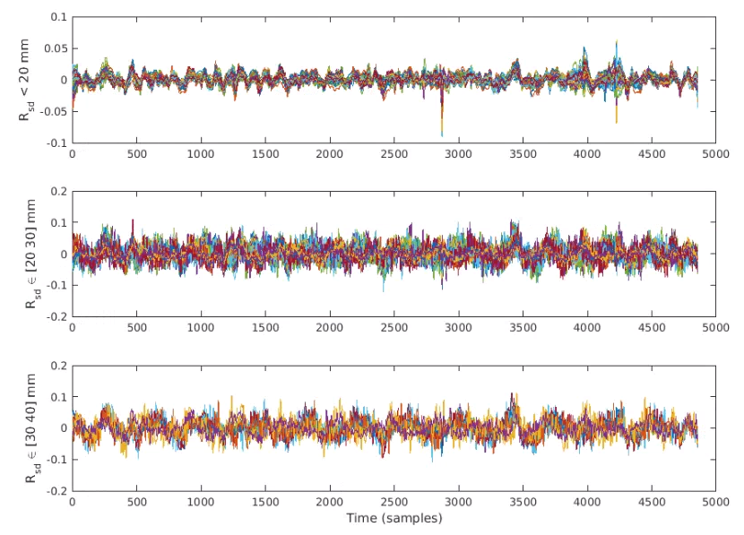
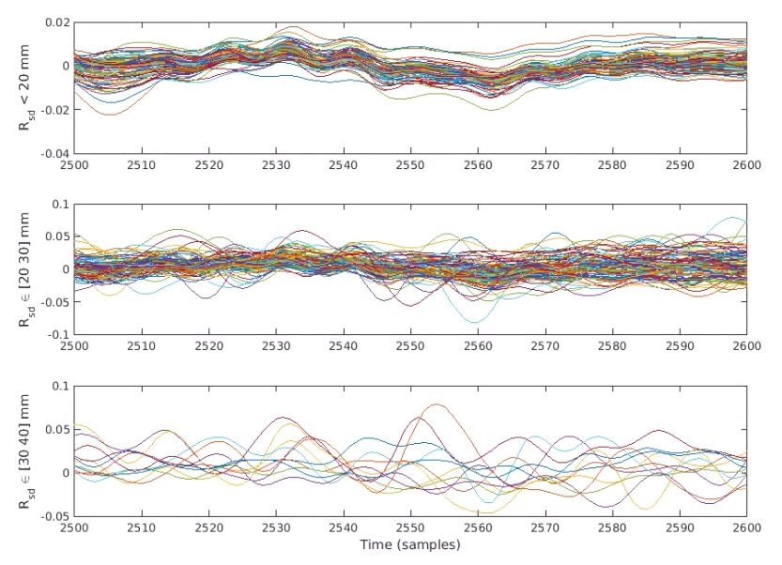
Low-pass filter zoom
The filtered measurements now show reduced high-frequency (rapidly varying) signal components, apparent at all source-detector distances
The zoomed view shows that the 1Hz cardiac pulse signal is no longer apparent. Accordingly, at the zoomed time scale (10 seconds shown in this plot), very few features of interest are apparent
Variation at the stimulus frequency is not yet clear in the full-length time traces

Slide 14

Superficial signal regression
A common signal is estimated from the superficial measurements and regressed out of all measurements
hem = gethem(lp1data, info);
[SSRdata, ~] = regcorr(lp1data, info, hem);
The time traces plot shows a little less high-frequency noise
The image of the measurement time traces shows an even clearer periodic response to the stimulus
The spectrum shows a much stronger peak at the stimulus frequency relative to other frequencies

Slide 15
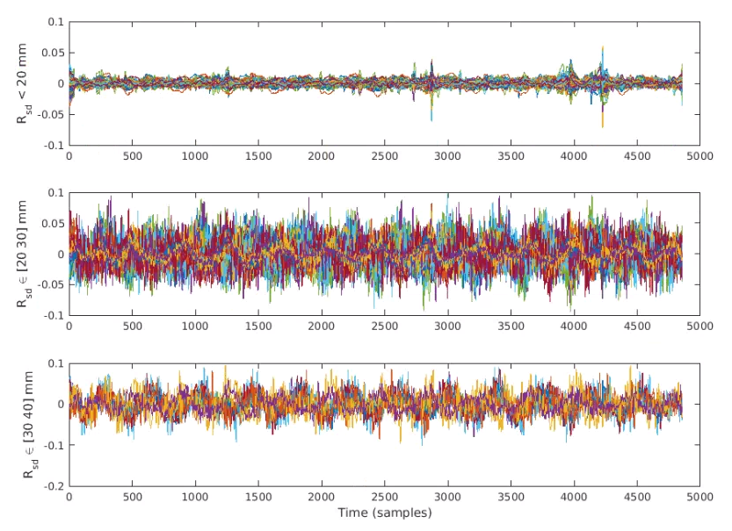
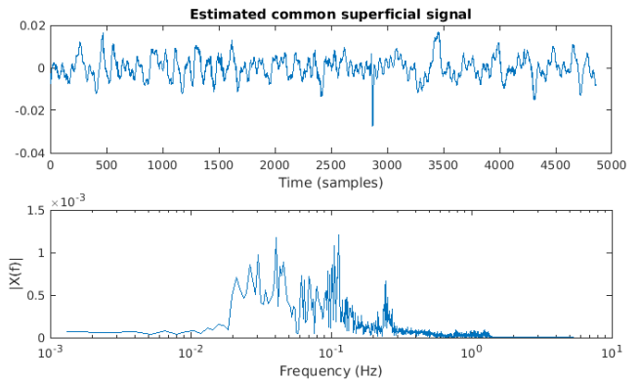
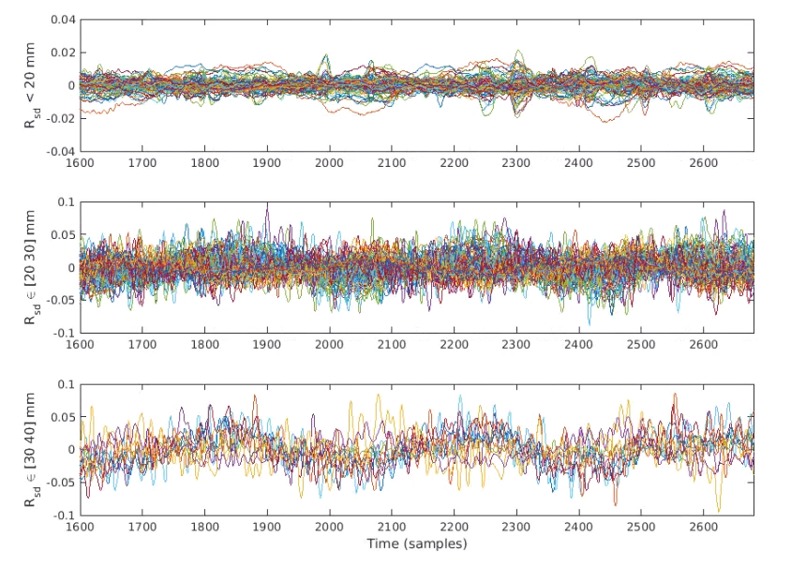
Superficial signal regression
Plot the estimated superficial signal and its frequency spectrum (above)
subplot(2,1,1)
plot(hem(2,:))
title('Estimated common superficial signal')
xlabel('Time (samples)')
subplot(2,1,2)
[ftmag,ftdomain] = fft_tts(hem(2,:),info.system.framerate);
semilogx(ftdomain,ftmag), xlabel('Frequency (Hz)'), ylabel('|X(f)|') % plot vs. log frequency
xlim([1e-3 10])
The estimated signal captures features of the previous short-distance measurements. The spectrum shows components similar to previous measurements but without the stimulus frequency
After regression of this estimated signal, short-distance measurements show little structure, while medium- and long-distance measurements show periodic features
After producing the graph at top right, reduce the time range to 3 cycles of the stimulus period, e.g.,
for i = 1:3, subplot(3,1,i), xlim([1600 1600+360*3]), end
This zoomed view clearly shows three cycles of the stimulus response

Slide 16
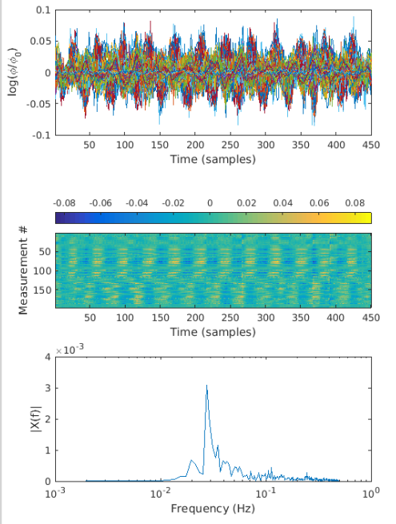
Second LPF and resampling
An additional low pass filter attenuates frequencies above 0.5 Hz
lp2data = lowpass(SSRdata, 0.5, info.system.framerate);
Data are then resampled to 1 Hz
[rdata, info] = resample_tts(lp2data, info, 1, 1e-5);
The 2nd LPF further reduces noise visible in the time traces, showing more emphasis on the stimulus response
Note that there are fewer time samples (reduced by a factor of 10) due to resampling
The spectrum is now displayed only to 1 Hz

Slide 17
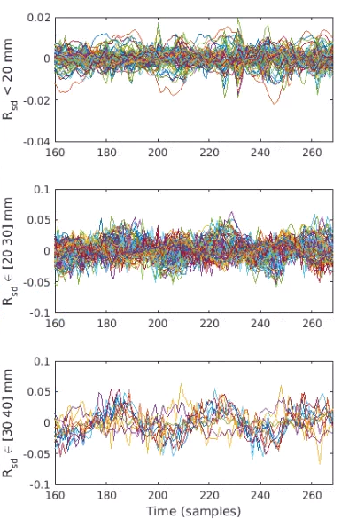
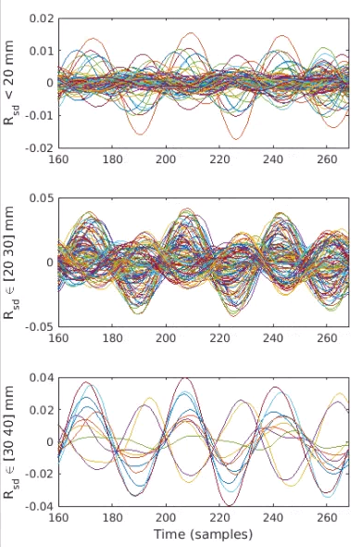
Second LPF and resampling - detail
The second LPF further attenuates rapidly varying (high-frequency) noise
Reducing the filter cutoff frequency from 0.5 Hz to 0.05 Hz drastically reduces the high-frequency noise, leaving only waveforms at the stimulus frequency, but at the expense of altering temporal features of the stimulus response at 0.028 Hz and possibly altering the phase of that response
Cutoff of 0.5 Hz
Cutoff of 0.05 Hz

Slide 18
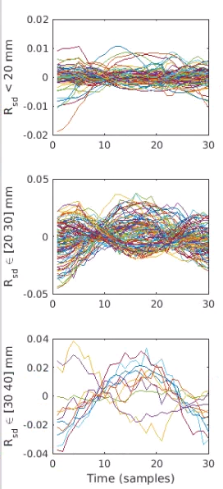
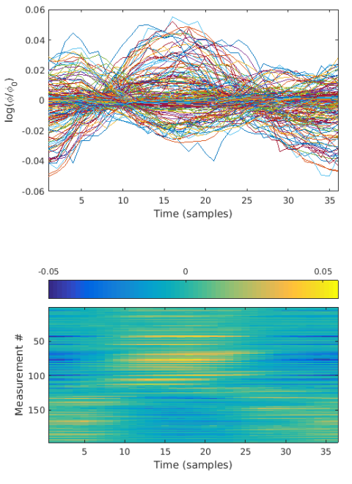
Block averaging
The measurements are block-averaged based on the stimulus synchronization points stored in info.paradigm
badata = BlockAverage(rdata, info.paradigm.synchpts(info.paradigm.Pulse_2), 36);
The time traces now show clear responses to the stimulus, here a rotating flickering checkerboard wedge with the image array over visual cortex.
The measurement image shows spatial variation of the response, as expected as the wedge rotates through the visual field.
More details about the stimulus paradigm and expected responses can be found in Eggebrecht et al., Neuroimage, 2012.
Plotting based on source-detector distance shows that medium- and long-distance measurements comprise nearly all of the strong stimulus responses.

Slide 19
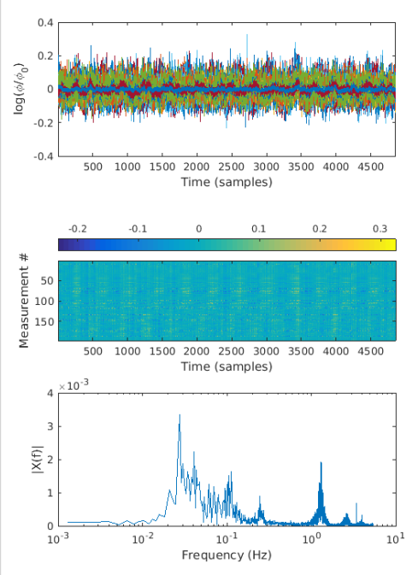
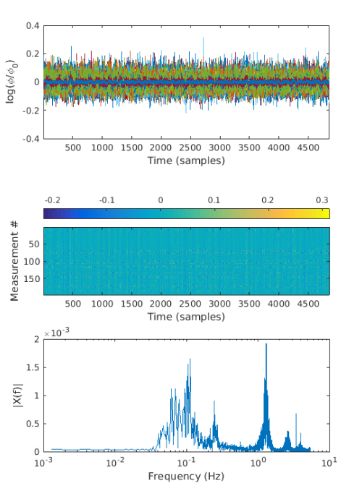
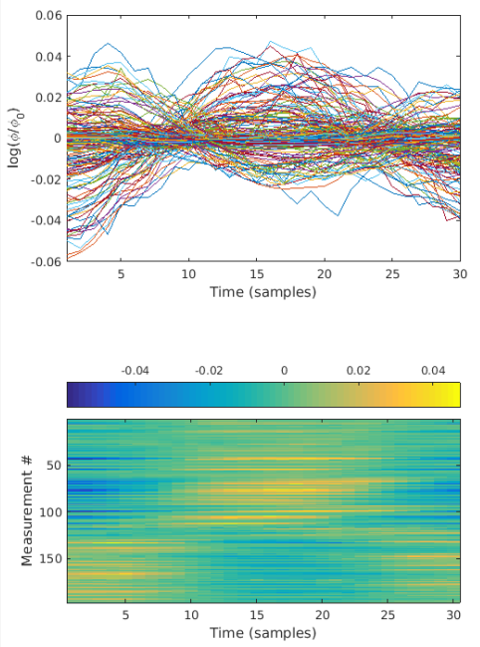
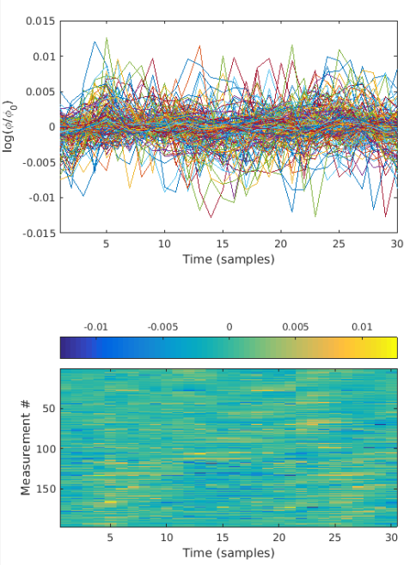
Appendix – High-pass cutoff frequency
Our usual selection for the cutoff frequency of the high-pass filter is 0.02 Hz. At this frequency, slowly-varying signals are attenuated, while passing higher-frequency signals.
Raising the cutoff frequency removes additional signal components, but going too high, e.g., 0.05 Hz, removes the frequency of interest, the stimulus frequency at ~-.028 Hz.
Signals and spectrum (above) and block-averged results (right) using HPF at 0.02 Hz
Signals and spectrum (above) and block-averged results (right) using HPF at 0.05 Hz

Slide 20
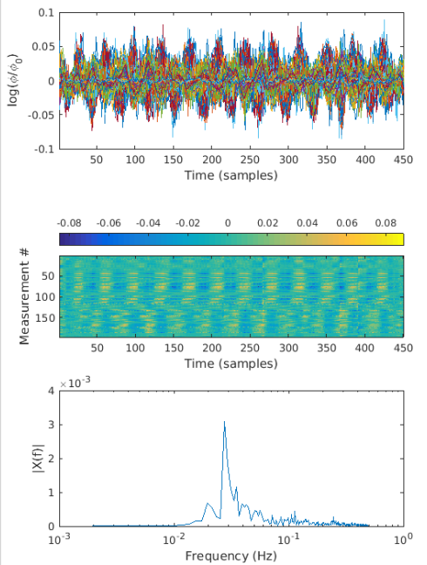
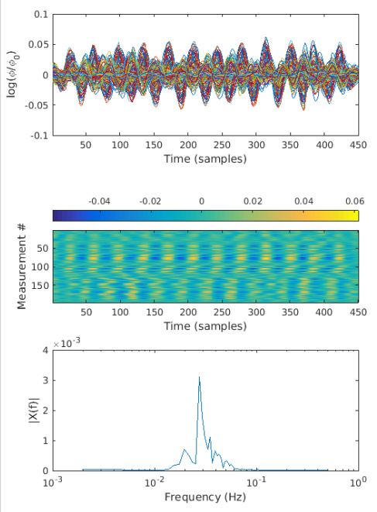
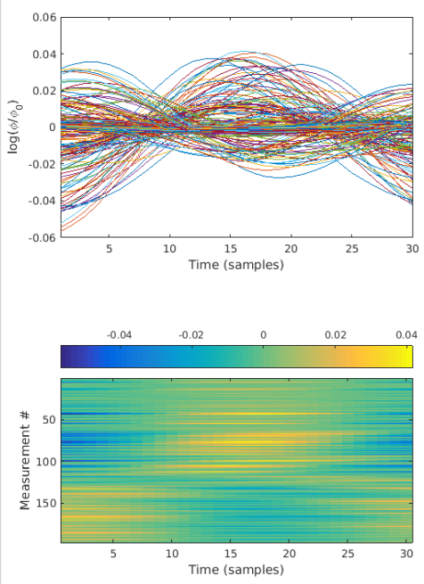
Appendix – Low-pass cutoff frequency
A typical selection for the cutoff frequency of our second low-pass filter is 0.5 Hz.
Lowering the LPF cutoff frequency removes additional signal components, but at the possible of expense of distorting the signals of interest. Decreasing to 0.05 Hz produces signals that are nearly sinusoidal
Signals and spectrum (above) and block-averged results (right) using LPF at 0.5 Hz
Signals and spectrum (above) and block-averged results (right) using LPF at 0.05 Hz

Slide 21
Help Expand NeuroDOT’s Utility!
Please fill out the NeuroDOT registration form to help us better develop the NeuroDOT toolbox and expand its utility to address your fNIRS/DOT data analysis needs:
https://forms.gle/8QNGnx7ZbKuUHg3bA
Additionally, please provide specific feedback, or ask questions to the development team:
https://forms.gle/jv6RkX5s784LgQC89
Note: you will not be contacted by the NeuroDOT development team unless you opt-in to receiving communications.

Slide 22
That’s It (For Now)
Congratulations! You have finished the NeuroDOT Preprocessing Tutorial
You are now ready to start the other NeuroDOT Tutorials
Recommended order for the tutorials is:
Generating a Light Model
Preprocessing
Image Reconstruction
Full Data Processing
Generating a Light Model PAD Adult 96x92
If you have any questions about the material presented in this tutorial, please consult the Optical Radiology Lab (ORL) GitHub page https://github.com/WUSTL-ORL/NeuroDOT_Beta in the documentation folder, or contact NeuroDOT Support: neurodot-support@wustl.edu

